Slide 1




AI-Powered Predictive Maintenance for Industrial Equipment
Under supervision: Eng/Abdelrhman Elmashtoly

Slide 2


Table of Content
1
2
3
4
5
6
7
8
9
10
11
12
Introduction
Project goals
Milestone 2
Milestone Process
Time-Series Analysis
Anomaly Detection
PCA
Feature Engineering
Data Visualization & Insights
Deliverables
Conclusion
Our Team

Slide 3

Introduction
AI-Powered Predictive Maintenance for Industrial Equipment:
Industrial equipment failures cause costly downtime and reduced productivity.
Traditional maintenance approaches (reactive or scheduled) are inefficient.
Predictive Maintenance leverages AI + IoT sensor data (vibration, temperature, pressure, humidity) to forecast failures.
This project develops a system to predict equipment issues before they occur, improving operational efficiency.

Slide 4

Project goals
01
Reduce Unplanned Downtime – Predict failures early to keep operations running smoothly.
02
Cut Maintenance Costs – Avoid unnecessary servicing and emergency repairs.
03
Improve Safety – Detect risks early to protect workers and operations.
04
Enable Data-Driven Decisions – Use AI insights to plan maintenance and improve efficiency.

Slide 5

Milestone 2: Advanced Data Analysis and Feature Engineering
Objectives:
Enhance feature extraction and perform advanced analysis to improve model accuracy
Tasks:
Advanced Data Analysis
Feature Engineering
Data Visualization

Slide 6




Milestone Process
1- Advanced Data Analysis
Perform time-series analysis to identify trends, cyclical patterns, and anomalies within the sensor data.
Use statistical methods such as Principal Component Analysis (PCA) for dimensionality reduction to identify critical failure indicators or combinations of features that contribute most to predictive accuracy.
2. Feature Engineering:
Develop new features
Rate of change in temperature, vibration, or pressure over time.
Degradation patterns, indicating how specific sensor readings change as equipment deteriorates.
Derived statistical features, like moving averages and rolling statistics, to smooth out noise and capture important trends.
3. Data Visualization:
Create visualizations (e.g., heatmaps, time-series plots) to highlight degradation patterns, sensor anomalies, and other key features.

Slide 7

Time-Series Analysis
1- Analyzing Sensor Trends Over Time
Plotted Temperature vs Operational Hours to study sensor behavior.
Applied Seasonal Decomposition to extract trend, seasonality, and residual patterns.
Identified cyclical variations and underlying patterns in sensor data.
Helps detect early indicators of equipment degradation.

Slide 8
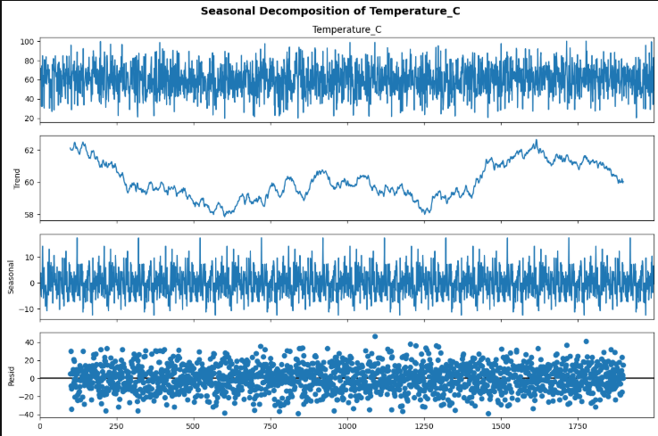
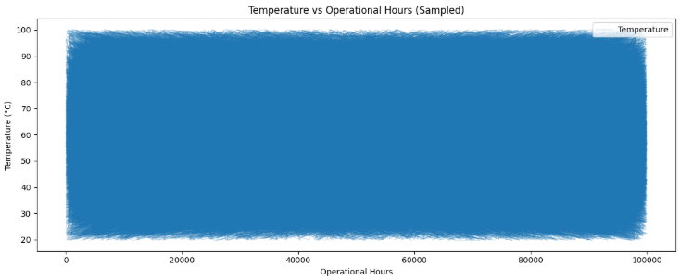

Slide 9
Anomaly Detection
2- Dimensionality Reduction & Feature Importance
Standardized features and reduced to 5 Principal Components.
Explained Variance Ratio shows how much information each PC captures.
Identified top contributing features to equipment failures.
Visualized PC1 vs PC2 for separation between Failure and No-Failure cases.

Slide 10
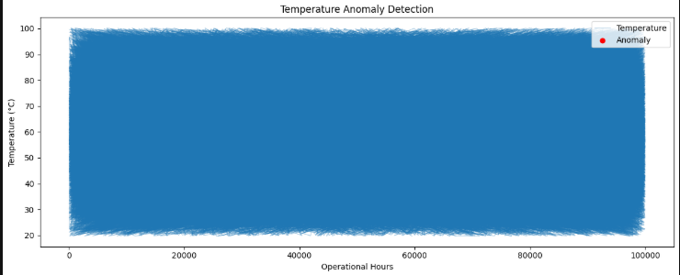

Slide 11
Principal Component Analysis (PCA)
3- Dimensionality Reduction & Feature Importance
Standardized features and reduced to 5 Principal Components.
Explained Variance Ratio shows how much information each PC captures.
Identified top contributing features to equipment failures.
Visualized PC1 vs PC2 for separation between Failure and No-Failure cases.

Slide 12
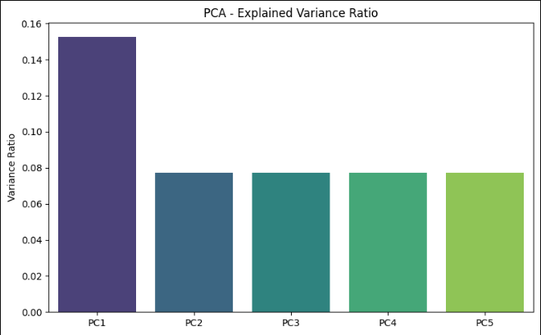
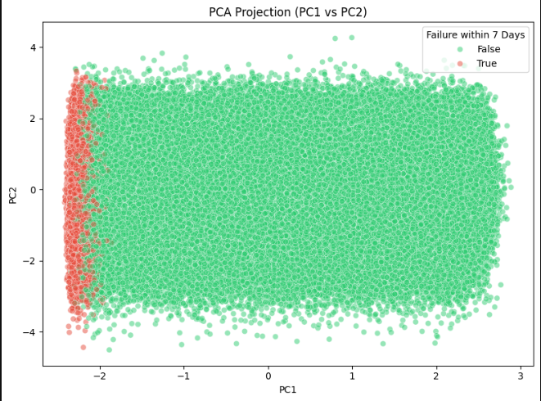

Slide 13
Feature Engineering: Rate of Change & Degradation Patterns
Objective:
Capture equipment behavior over time to detect early signs of failure.
Key Features Created:
Rate of Change:
Temp_RateChange: Change in temperature per unit operational time.
Vibration_RateChange: Change in vibration per unit operational time.
Pressure_RateChange: Change in pressure/power per unit operational time.
Degradation Patterns:
Temp_Degradation: Increase in temperature relative to initial value.
Vibration_Degradation: Increase in vibration relative to initial value.
📌 These features highlight how quickly sensors deviate and how equipment gradually deteriorates.

Slide 14
Feature Engineering : Rolling Trends & Noise Reduction
Objective:
Smooth sensor data and capture long-term patterns.
Techniques Applied:
Rolling Trends (Window = 50):
Temp_Trend & Vibration_Trend: Average slope of change → detects gradual upward or downward drift.
Rolling Statistics (Noise Reduction):
Moving Average (Temp_MA_50, Vibration_MA_50, Pressure_MA_50) → smooths fluctuations.
Standard Deviation (Temp_STD_50, Vibration_STD_50, Pressure_STD_50) → measures stability/variability.
Visualization Example:
Plot shows raw temperature data vs. rolling average → smoother curve, easier trend detection.
📌 These engineered features help models focus on underlying equipment behavior rather than noise.

Slide 15
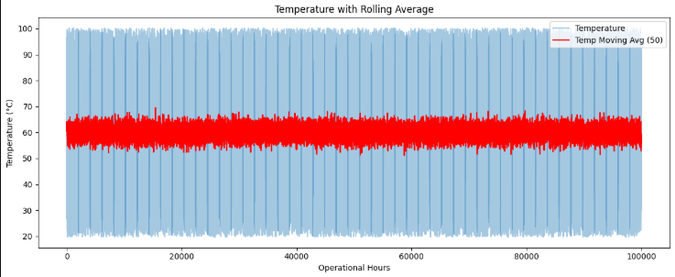

Slide 16
Data Visualization & Insights
Objective: Identify degradation patterns, anomalies, and sensor relationships.
Visualizations Created:
Correlation Heatmap → Highlights relationships between sensors (e.g., vibration ↔ power).
Degradation Patterns (Time-Series) → Tracks how temperature & vibration rise as equipment ages.
Rolling Trends (Moving Averages) → Smooths noisy data to reveal underlying patterns.
Boxplots → Detect outliers in temperature, vibration, and power consumption.
📌 These visualizations reveal both gradual deterioration and sudden abnormal behaviors.

Slide 17
Data Visualization & Advanced Analysis (FFT & Feature Extraction)
Objective: Extract deeper insights from sensor signals.
Techniques Applied:
Rolling Min/Max Windows (size=10): Captures short-term fluctuations for anomaly detection.
FFT (Fast Fourier Transform) Features:
fft_mean → Average signal frequency strength.
fft_peak → Maximum vibration frequency (critical for detecting faults).
fft_energy → Total signal power, useful for detecting abnormal machine vibrations.
📌 FFT helps uncover hidden frequency-domain patterns that time-series alone cannot capture.

Slide 18
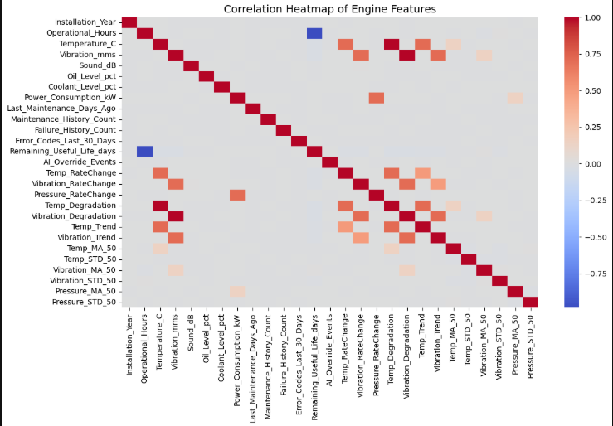
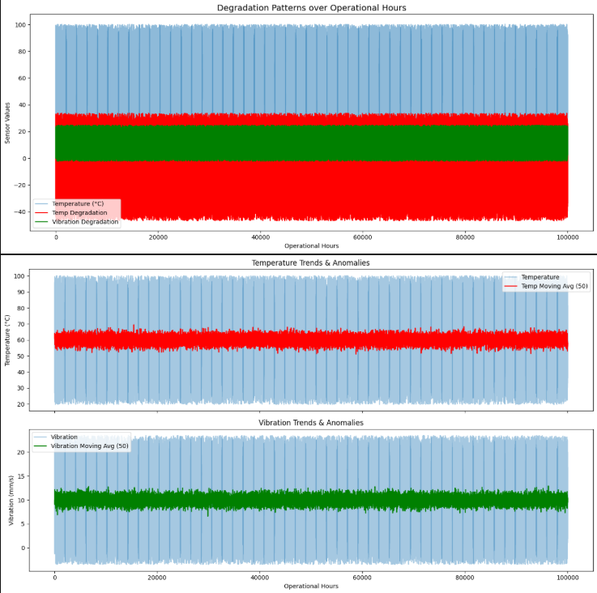
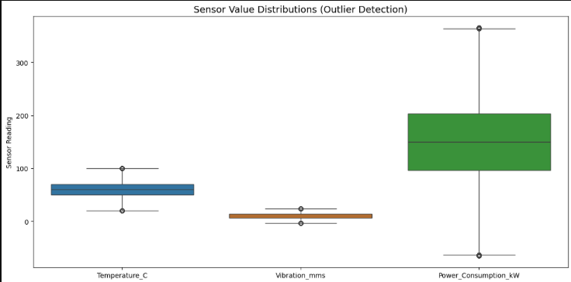

Slide 19


Deliverables
01
Advanced Analysis Report: A detailed report summarizing insights derived from the advanced analysis and identifying key failure indicators.
02
Visualizations: Dashboards or plots that effectively communicate critical trends and degradation patterns.
03
Feature Engineering Summary: Documentation outlining the engineered features, their expected impact on predictive performance, and rationale for their inclusion.

Slide 20

Conclusion
Extracted new features (rate of change, degradation, rolling statistics) → improved representation of equipment health.
Applied PCA & time-series analysis → identified key indicators and reduced dimensionality.
Built visualizations (heatmaps, trends, FFT, boxplots) → highlighted anomalies and long-term degradation patterns.
Established a strong foundation for predictive modeling in the next milestone.
📌 Milestone 2 transformed raw sensor data into actionable insights, enabling accurate failure prediction.

Slide 21
Our Team
Ahmed Maged Motea
Ahmed Yasser Shehata
Ashraf Ahmed Salah
Sama Ibrahim Moheb
Mohamed Elshamy
Mohamed Atef

Slide 22

Thank You
GitHub Repo - Link

